Slide 1
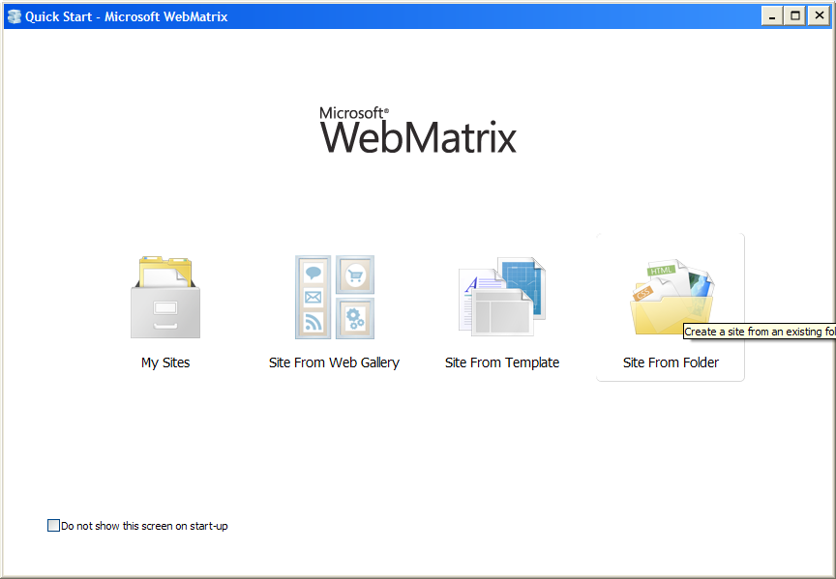
Select Site from folder

Slide 2
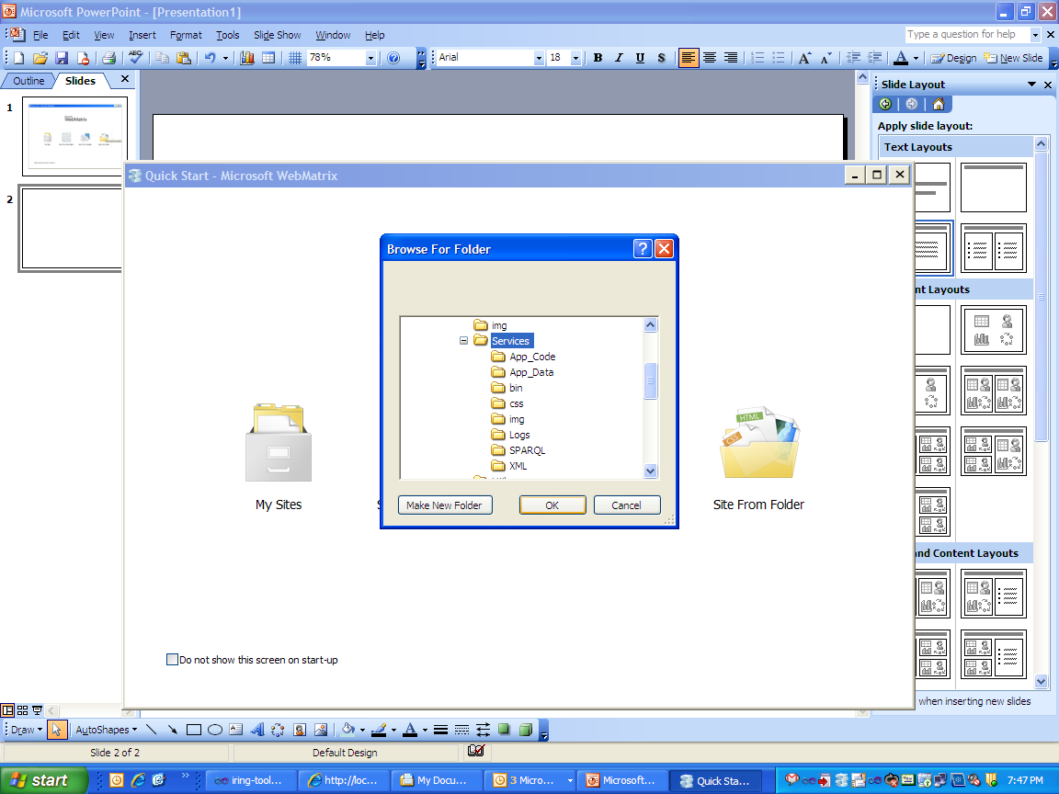
Create site for Services

Slide 3
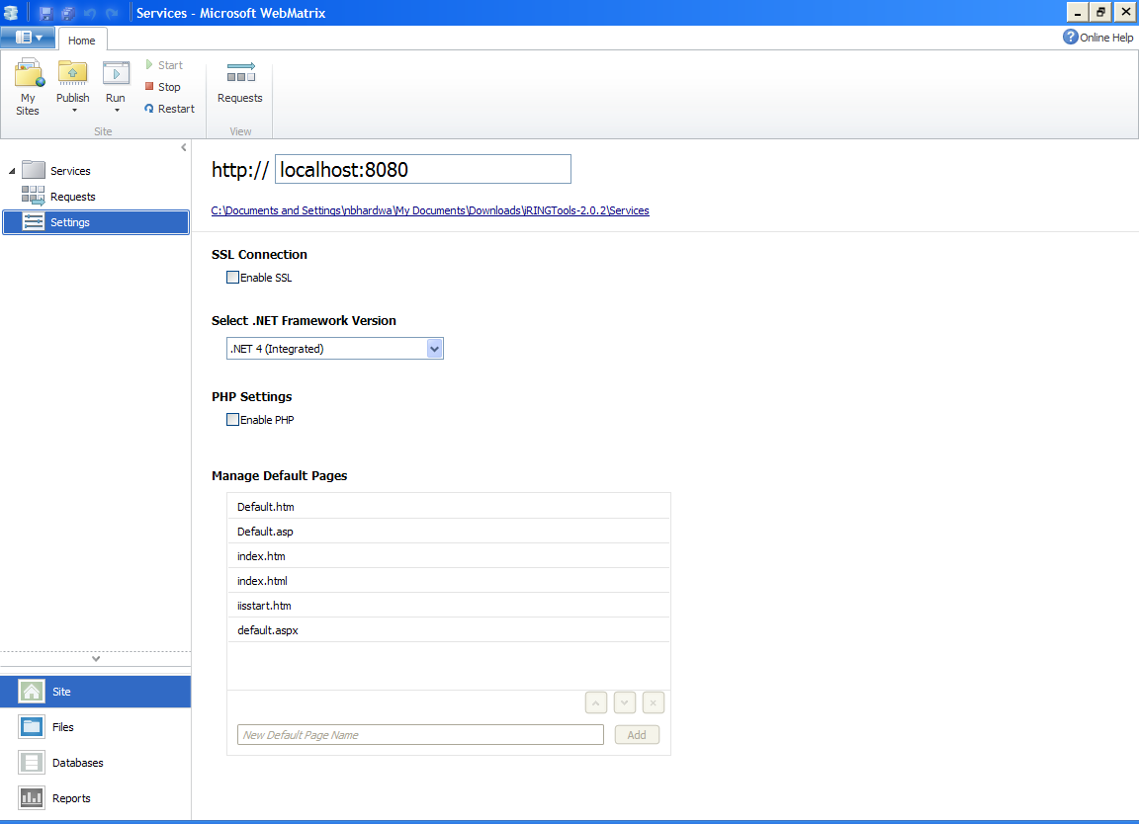
Assign the port

Slide 4
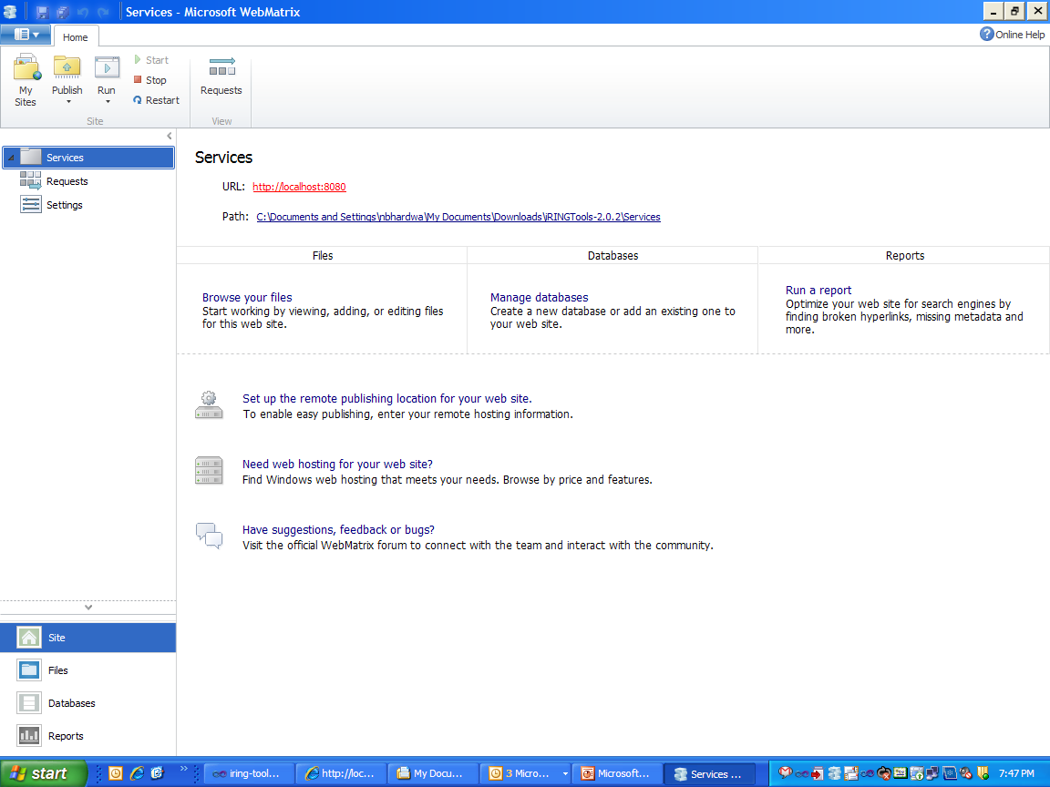
Click to run

Slide 5
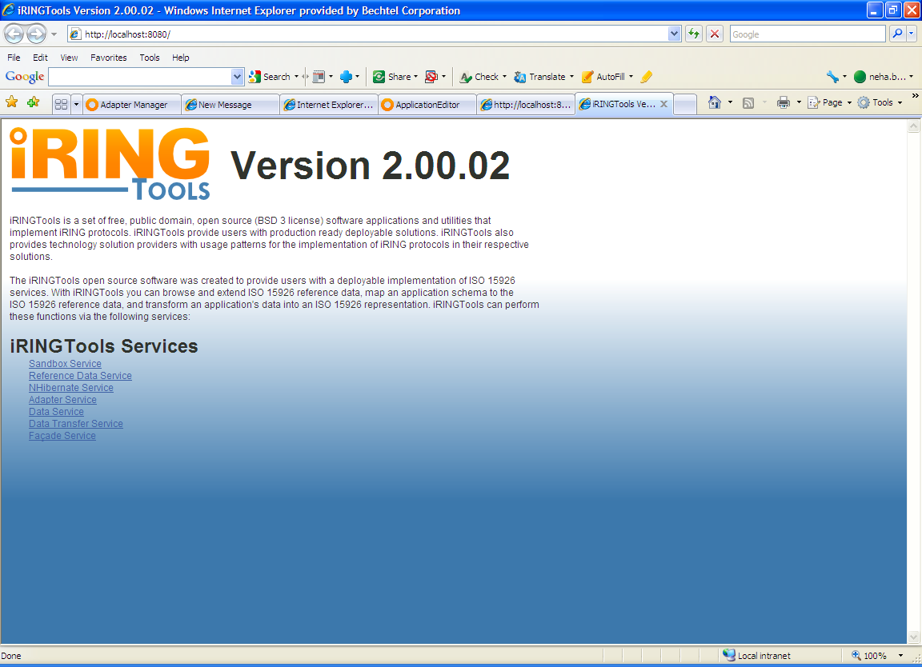

Slide 6
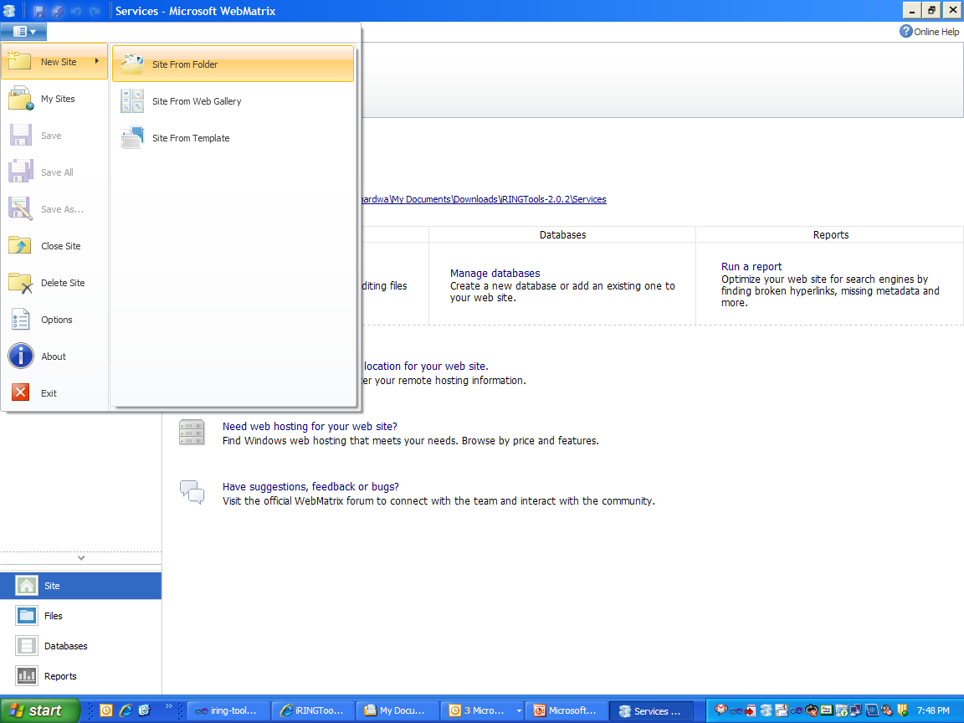
Select to create another site for Apps

Slide 7
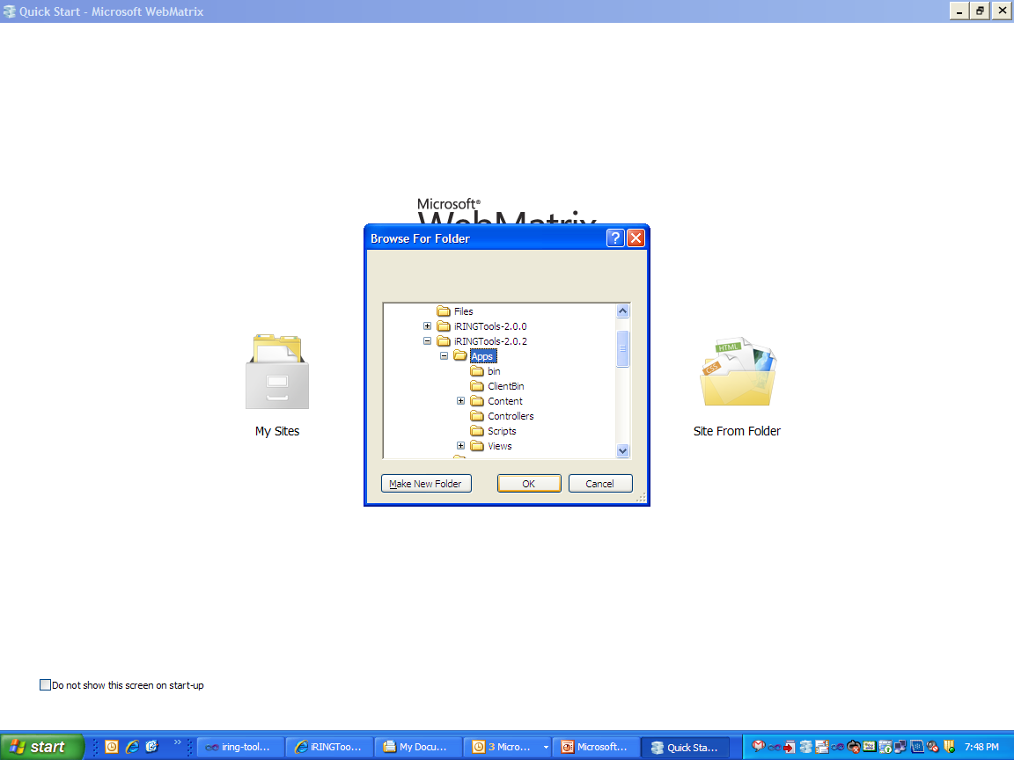

Slide 8
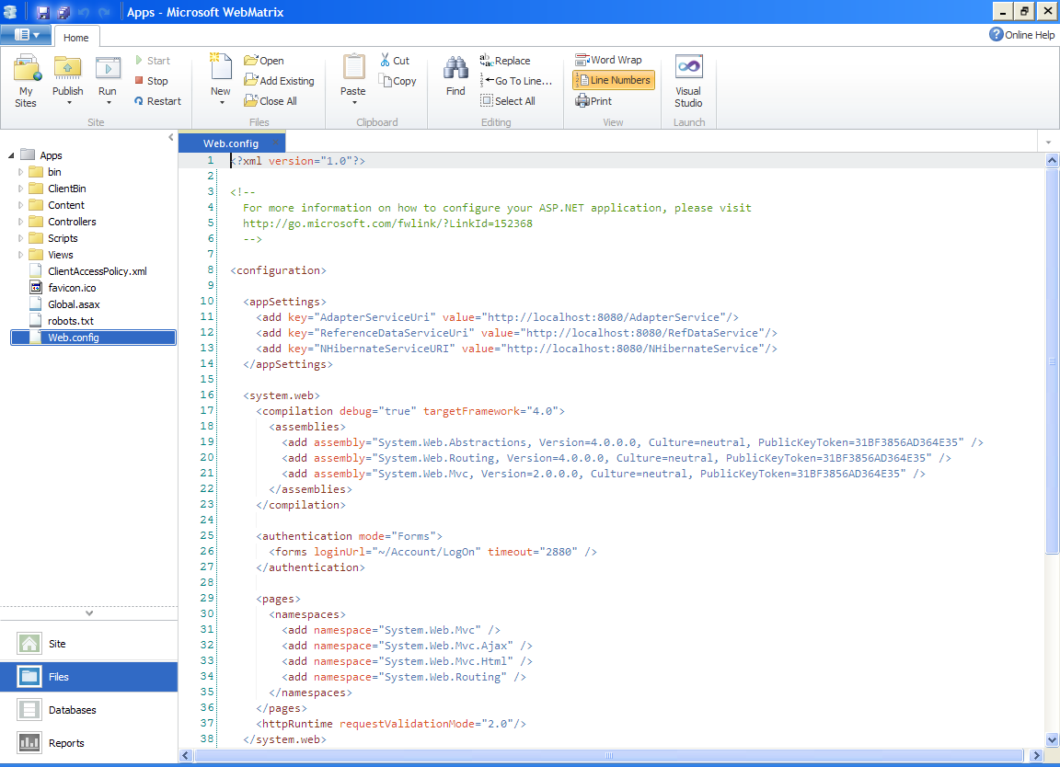
Update Web.config of Apps project

Slide 9
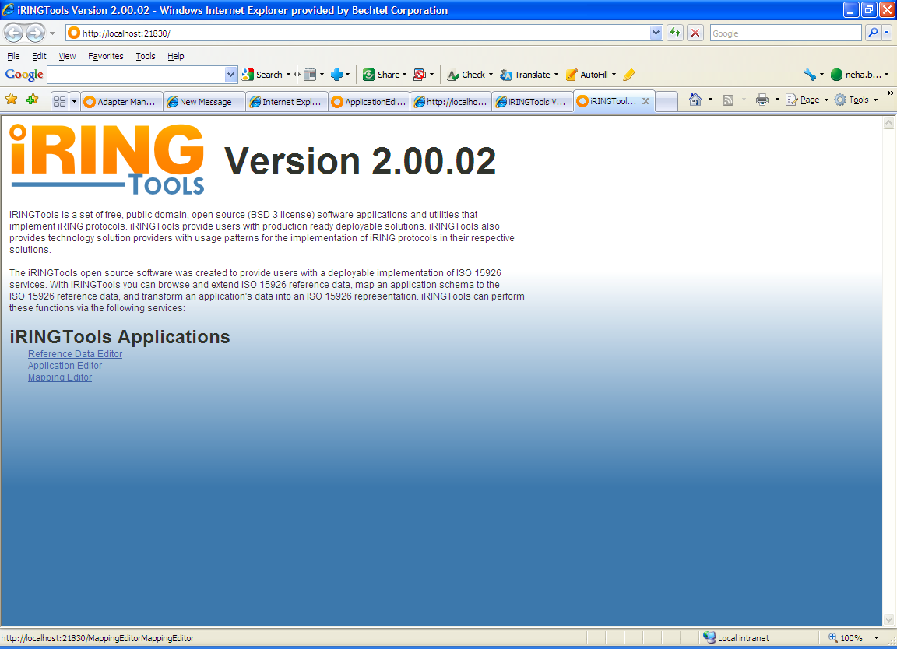
Note: Open two instances of WebMatrix as it doesn't
have options to open multiple projects/sites

Slide 10
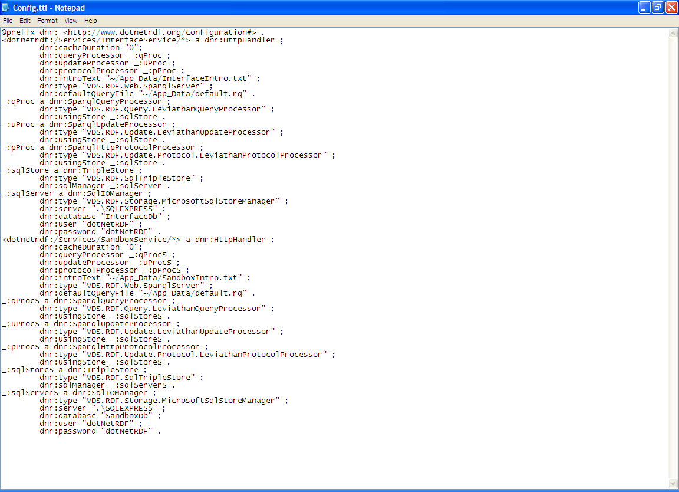
Update Config.ttl file
(File Location: Service->App_Data->Config.ttl)
Remove “Services”
Update your SQL Server name in case your
SQL Server is not on your local machine

Slide 11
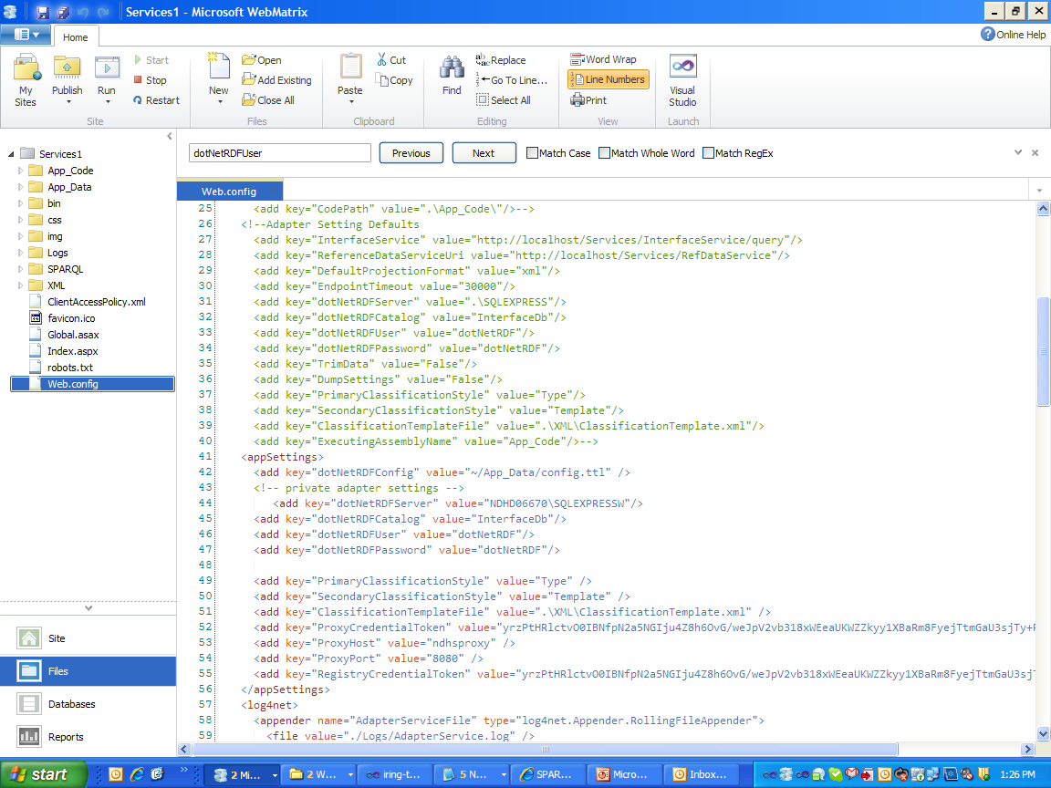
Changes in Service-> Web.Config
Copy this and Paste in down
in <appSettings>.
2. Update Sql Server Name

